Slide 1
Anthropology and One Health
Dr. Elizabeth Elliott

Slide 2
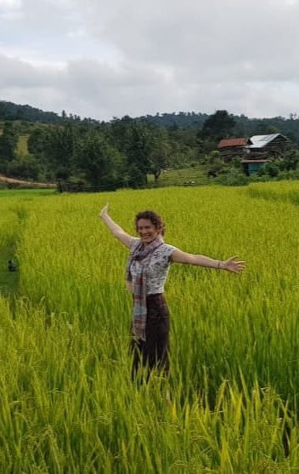
About me
PhD Anthropology, University College London – thesis on traditional medicine in Laos
Post-doctoral fellow, Science, Technology and Society Cluster, Asia Research Institute
Consultant for global health organizations and NGOs
I’ve been living in southeast Asia for many years – feels like home!

Slide 3
My previous research &work in Laos
Medical anthropology and global health focused research in Laos, including:
Traditional medicine and ethno-pharmacology/botany
Maternal and child healthcare, integrated service delivery
Malaria
Vaccination including COVID-19
Relational community engagement and trust-building with health and governance sector

Slide 4
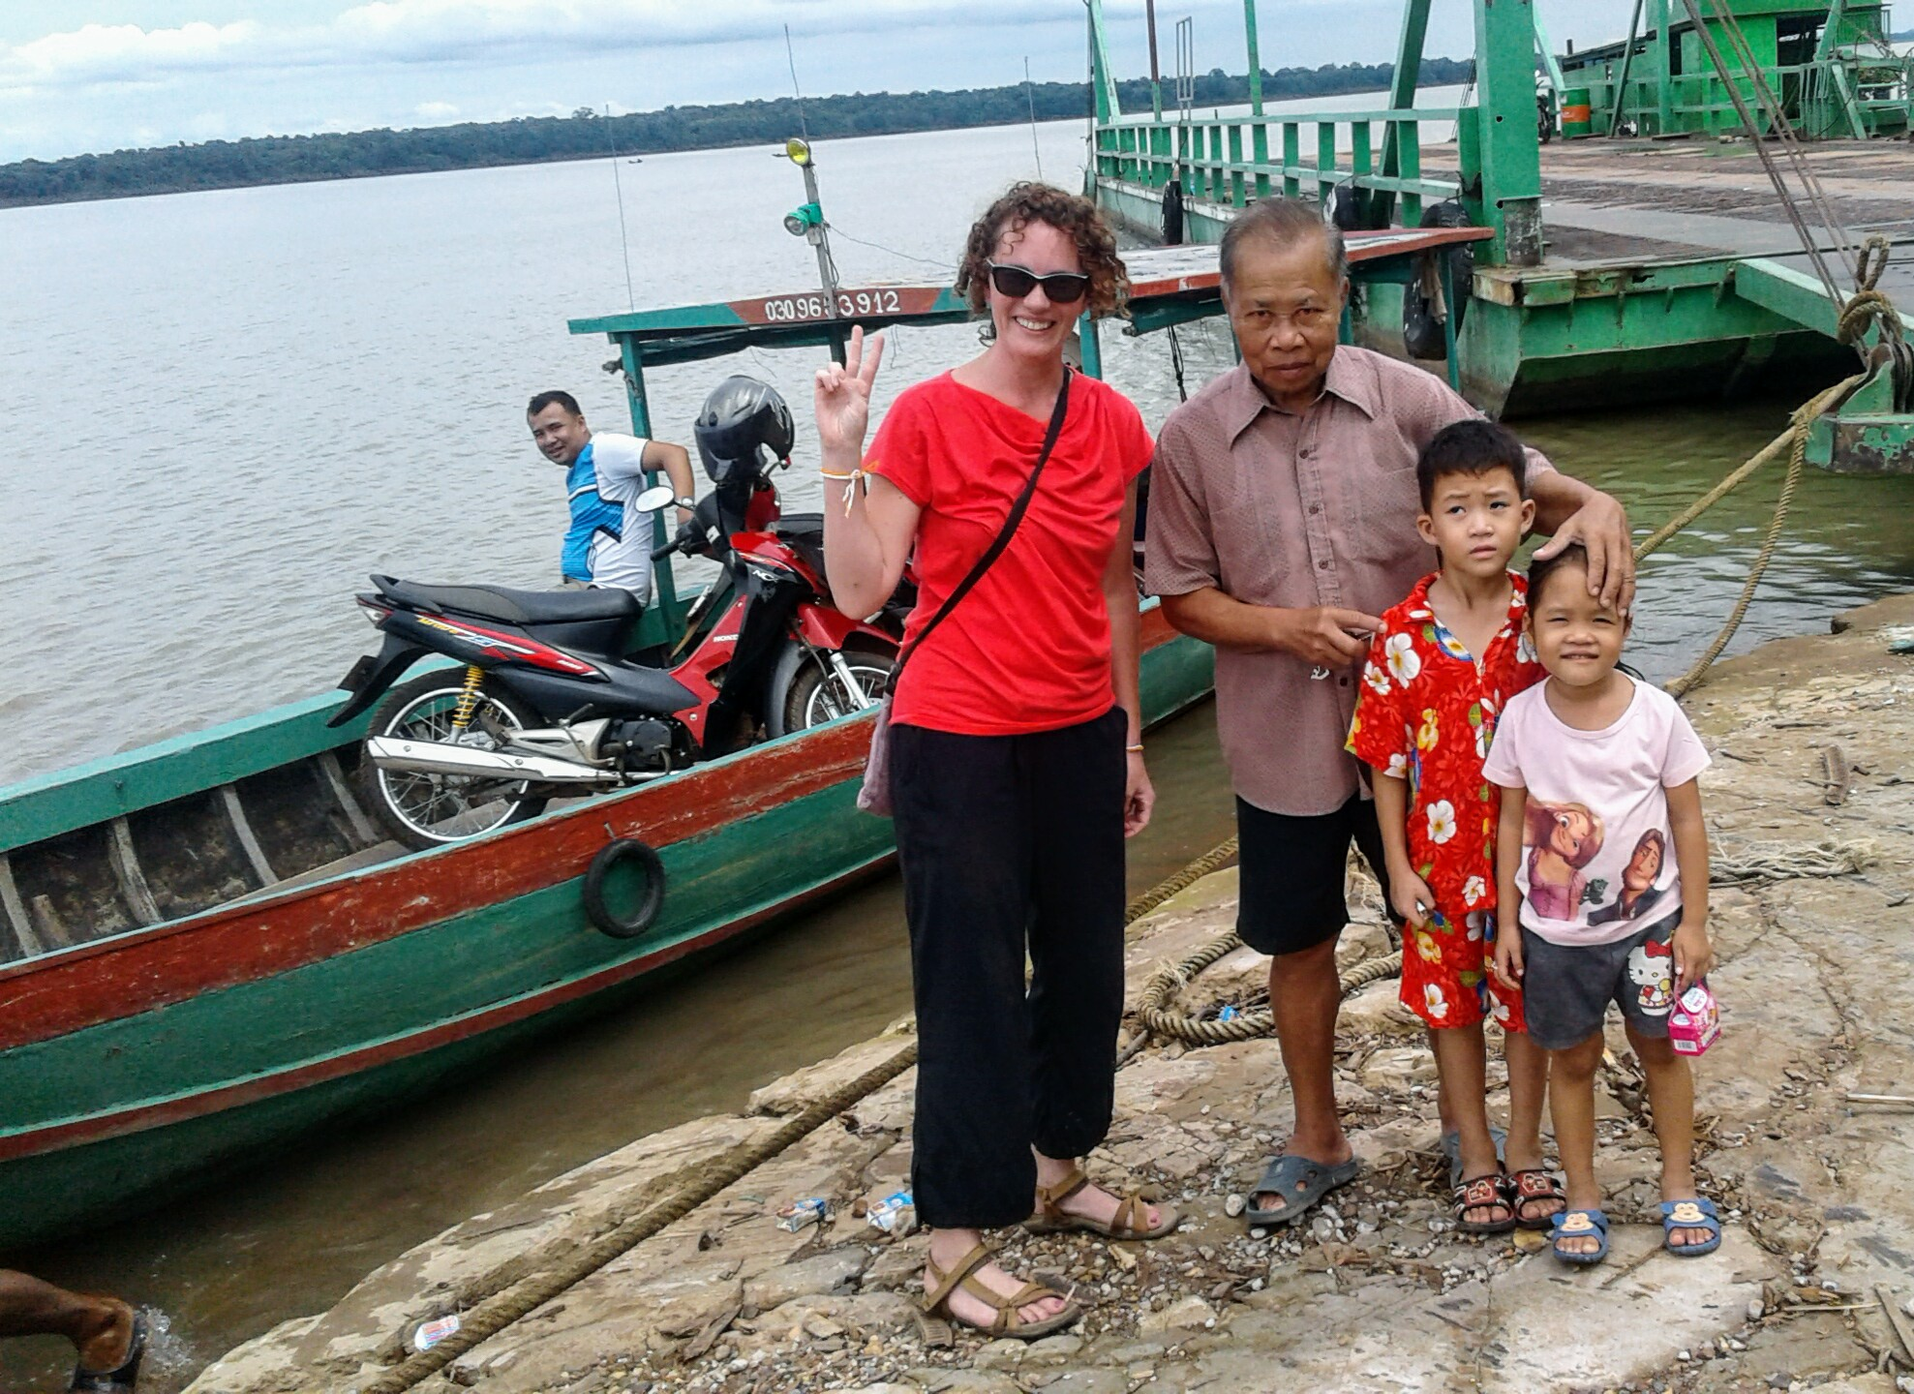
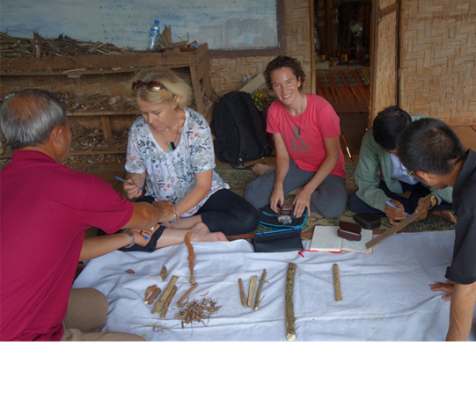
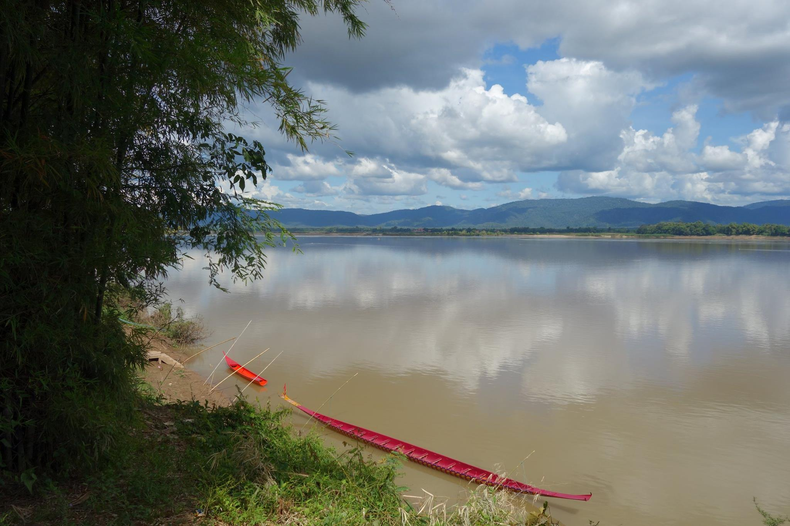
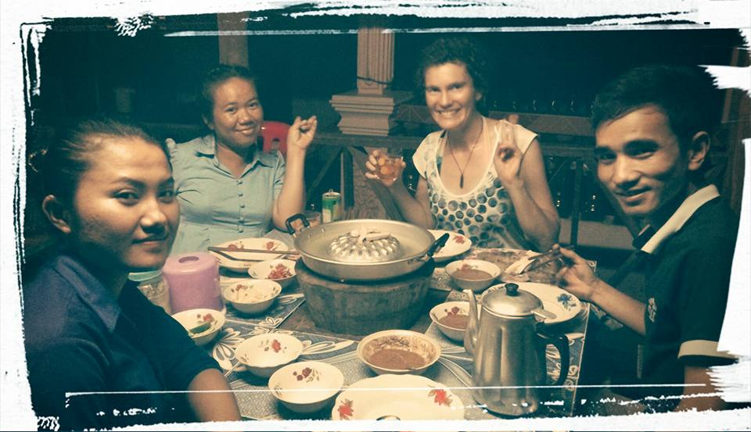
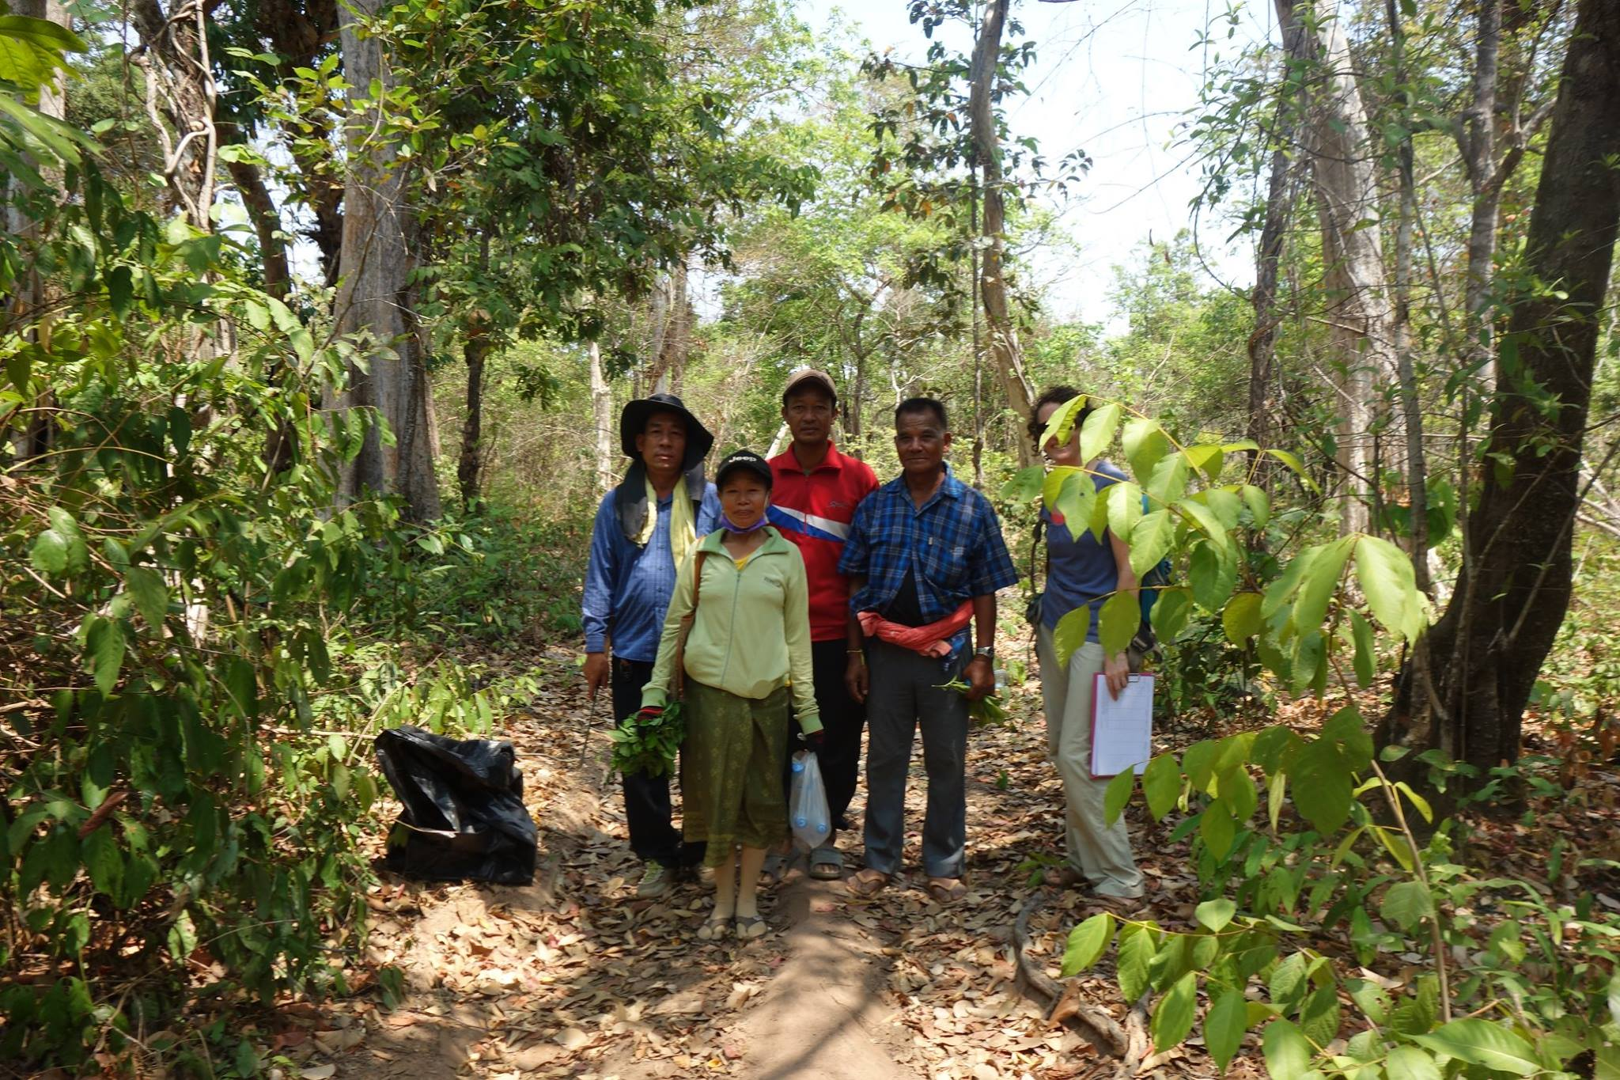
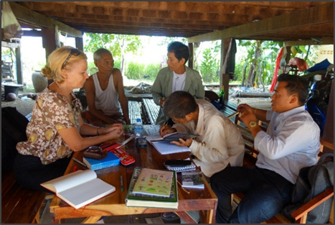
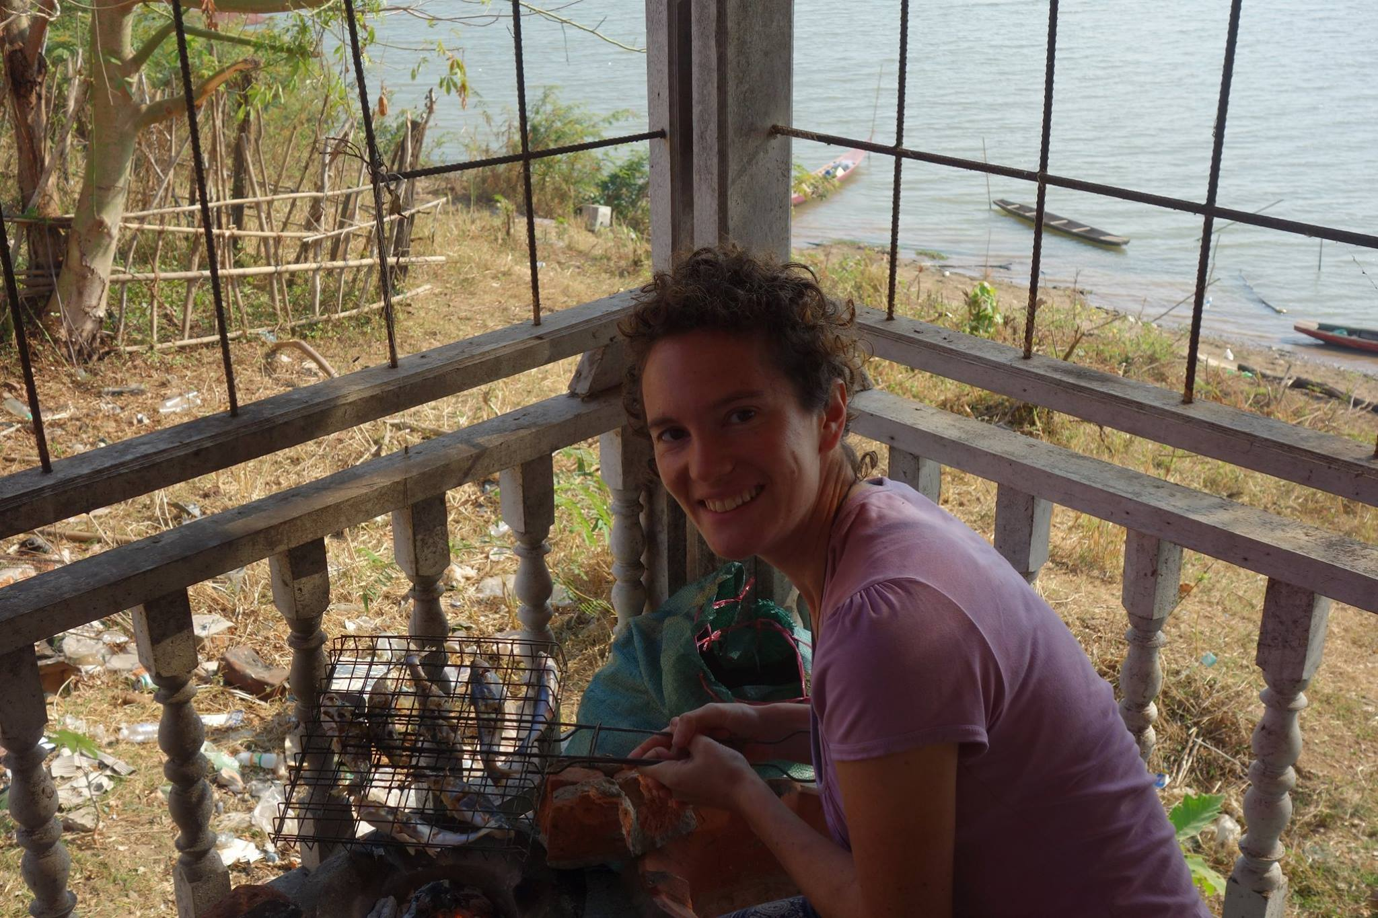
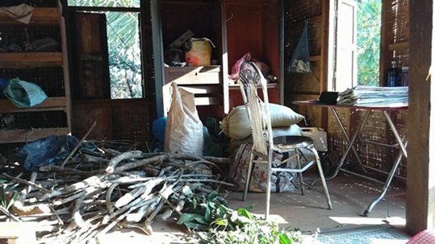

Slide 5
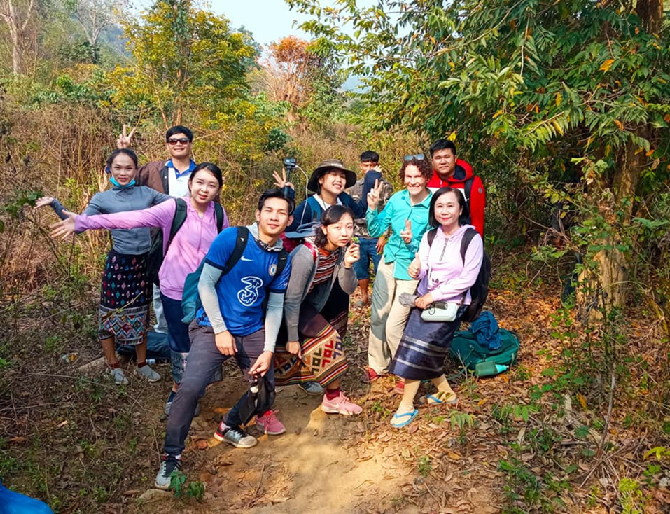
Methods and approach
Ethnographic fieldwork
Participatory approaches
Co-developing interventions
Film-making and other media outputs
Working with Lao students
Ethnobotany
Fieldwork (literally) in northern Laos with Lao Tropical and Public Health master students

Slide 6
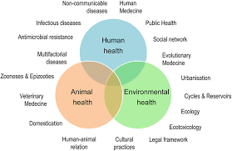
Anthropology and One Health
- What does “One Health” mean from a theoretical perspective?
- Medical anthropology explores the emergence and spread of disease as a bio-cultural phenomenon

Slide 7
Human-animal-environment interactions
Taking a “multi-species” approach
The social dimensions of human, animal and environment interactions
Behaviours in the context of zoonotic disease emergence

Slide 8
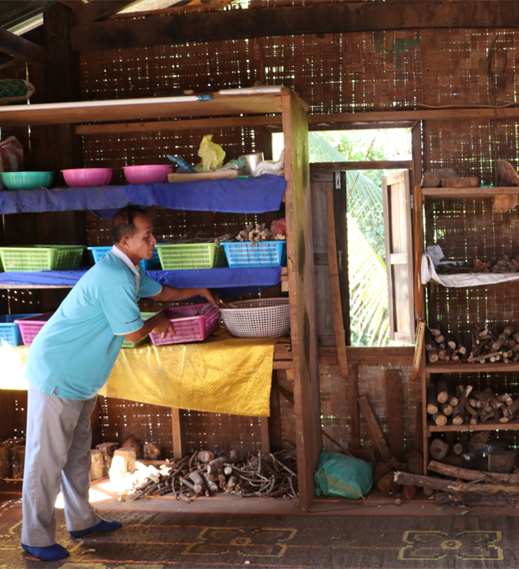
Traditional ecological knowledge
Biodiversity decline and environmental change has been closely associated with the loss of indigenous peoples, languages and knowledge,
Traditional ecological knowledge is of increasing importance in addressing ecological and health crises including managing, preventing and responding to outbreaks

Slide 9
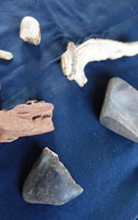
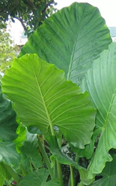
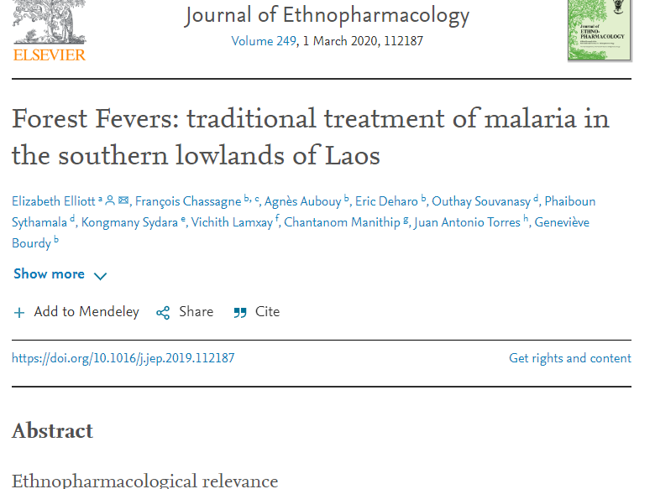
“Forest Fevers”
Research into traditional medicine in southern Laos identified how fevers are traditional categorised and treated, including for malaria
Analysis of collected prescriptions containing 47 identified plant species. The most-used plants also were also the most cited in the literature for use against malaria
Some of these species show promising results for future research, especially Amorphophallus paeniifolius (Dennst.) Nicolson and Alocasia macrorrhizos (L.) G. Don. ກະ​ພູກ which are easily cultivated.

Slide 10
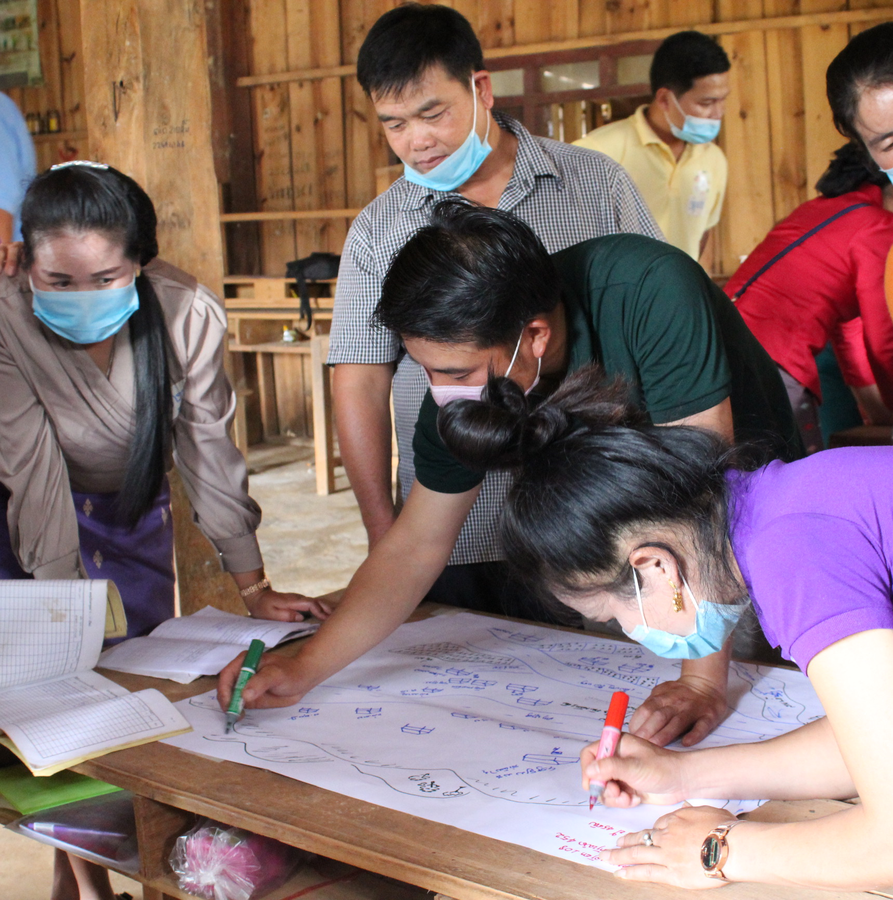
Community perspectives
Learning about community perspectives through ethnographic and participatory approaches such as mapping helps identify local priorities, knowledge and resources towards sustainable and locally-led interventions.

Slide 11
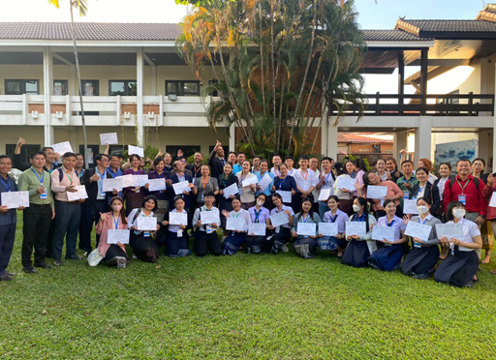
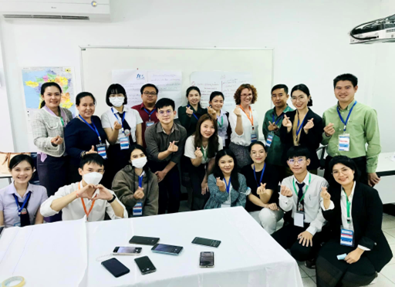
Developing capacity in social science for One Health

Slide 12
Thank you!
ขอบคุณ
ຂອບ​ໃຈ ขอบคุณ

